Slide 1
Math, Magic, and Mystery
James Propp
UMass Lowell
April 21, 2014

Slide 2
Mathematics Awareness Month
This year’s theme is “Mathematics, Magic, and Mystery” (not coincidentally also the title of a book by Martin Gardner).
Visit mathaware.org for new daily links to interesting mathematical content throughout April 2014.

Slide 3
Stage magic vs. real magic
Wonder vs. understanding

Slide 4
MATH
Two big changes in the past 200 years:
Method
Matter

Slide 5
Method
New standards of rigor
Rigor and intuition
Bolzano’s revolution

Slide 6
a quote from Paul Halmos
“The day when the light dawned ... I suddenly understood epsilons and limits, it was all clear,
it was all beautiful, it was all exciting. …
It all clicked and fell into place. I still had everything in the world to learn, but nothing was going to stop me from learning it. I just knew I could. I had become a mathematician.”

Slide 7
Subject matter
Higher-dimensional Euclidean geometries
Non-Euclidean geometries

Slide 8
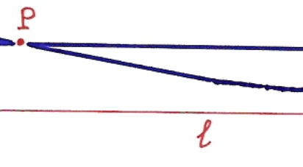
From universe to multiverse

Slide 9
Matter
Higher-dimensional Euclidean geometries
Non-Euclidean geometries
Strange number-systems
…

Slide 10
Matter
Higher-dimensional Euclidean geometries
Non-Euclidean geometries
Strange number-systems
…
Result: The liberation of math from reality (or should I say “from merely physical reality”)

Slide 11
The end result
Tools of the mind that were created to help us understand this world have been repurposed as tools for transcending it.

Slide 12
a quote from J. J. Thomson
“In fact, the pure mathematician may create universes just by writing down an equation, and indeed if he is an individualist he can have a universe of his own.”

Slide 13
MAGIC
Half Magic, by Edward Eager
The Magicians, by Lev Grossman
The Name of the Wind, by Patrick Rothfuss

Slide 14
from Half Magic
“The trouble with life is that not enough impossible things happen for us to believe in.”

Slide 15
from The Magicians
“A lot of the test was calculus, pretty basic stuff for Quentin.”

Slide 16
from The Magicians
“Quentin's other homework ... turned out to be a thin, large-format volume containing a series of hideously complex finger and voice-exercises arranged in order of increasing difficulty and painfulness. Much of spellcasting, Quentin gathered, consisted of very precise hand gestures accompanied by incantations to be spoken or chanted or whispered or yelled or sung. Any slight error in the movement or in the incantation would weaken, or negate, or pervert the spell.”

Slide 17
A typical definition
The limit of f(x) as x approaches a equals L
if and only if
for every ε > 0 there exists δ > 0 such that
every real number satisfying 0 < |x - a| < δ satisfies |f(x) – L| < ε .
(note use of symbols from an ancient language!)

Slide 18
A typical finger-exercise
Show: The limit of 2x as x approaches a is 2a.
Proof: Given ε > 0 , let δ = ε/2; then for every x satisfying 0 < |x - a| < δ we have |2x – 2a| = 2|x - a| < 2δ = ε, so |2x – 2a| < ε, as claimed.
(note summoning of ε/2 and binding of δ!)

Slide 19
Separation of worlds
Earth, Narnia, Charn, … (C.S. Lewis)
Earth, Fillory, … (Lev Grossman)
Geometry, statistics, number theory, …

Slide 20
Bridges between worlds
The Wood between the Worlds (C.S. Lewis)
The Neitherlands (Lev Grossman)
Some mysterious glue that holds math together and keeps it from splitting into unrelated specialties

Slide 21
a tale from Eugene Wigner
There is a story about two friends, who were classmates in high school, talking about their jobs. One of them became a statistician and was working on population trends. He showed a reprint to his former classmate. The reprint started, as usual, with the Gaussian distribution and the statistician explained to his former classmate the meaning of the symbols for the actual population, for the average population, and so on. (continued on next slide)

Slide 22
a tale from Eugene Wigner
(continued) His classmate was a bit incredulous and was not quite sure whether the statistician was pulling his leg. "How can you know that?" was his query. "And what is this symbol here?" "Oh," said the statistician, "this is pi." "What is that?" "The ratio of the circumference of the circle to its diameter." "Well, now you are pushing your joke too far," said the classmate, "surely the population has nothing to do with the circumference of the circle."

Slide 23
What is magic good for?
1. Wealth
2. Love
3. Invisibility
4. Power
5. Flight
6. Life
7. Time travel
8. Other worlds
9. Transformation
10. Harmony

Slide 24
1. Wealth

Slide 25
1. Wealth
Begs the question: what would you use it for?

Slide 26
2. Love

Slide 27
2. Love
Sorry, wrong profession.

Slide 28
3. Invisibility

Slide 29
3. Invisibility
Cloaking?
(But that’s applied math; I’m more interested in the multiverse of pure math.)

Slide 30
4. Power

Slide 31
4. Power
What if you could do an infinite amount of work with a finite amount of effort?

Slide 32
A theorem
For every positive integer n,
1 + 2 + 3 + … + n = n(n+1)/2.

Slide 33
That is:
1 = (1)(2)/2
1 + 2 = (2)(3)/2
1 + 2 + 3 = (3)(4)/2
1 + 2 + 3 + 4 = (4)(5)/2
1 + 2 + 3 + 4 + 5 = (5)(6)/2
…
Infinitely many things to prove!

Slide 34
The magic wand
Proof by induction: “Knock over the first domino, and the rest got knocked down automatically.”
But who set up the dominos?
How are our finite human minds able to master (aspects of) infinity?

Slide 35
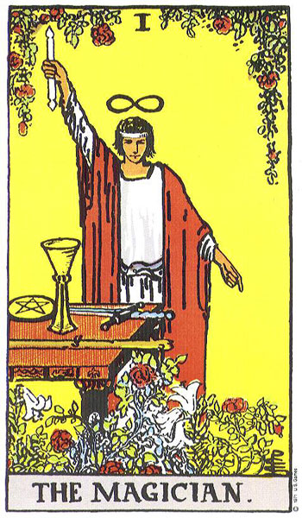

Slide 36
5. Flight

Slide 37
5. Flight
Check out
https://www.youtube.com/watch?v=tPlPnTev14s
(Your generation will make such fly-overs interactive.)

Slide 38
5. Flight
Check out
https://www.youtube.com/watch?v=tPlPnTev14s
The opposite of flying is burrowing, which can be magical too…

Slide 39
a quote from Galileo
“The Book of Nature is written in the language of mathematics.”

Slide 40
6. Life

Slide 41
6. Life
Would you really want to live FOREVER?
What would that even be like?
I think living five or six generations would probably be enough for me.
In the world of math research, we get to do this!

Slide 42
7. Time travel

Slide 43
A bogus proof
Show: The limit of 2x as x approaches a is 2a.
Proof: Given ε > 0 , let δ = ε; then for every x satisfying 0 < |x - a| < δ we have |2x – 2a| = 2|x - a| < 2ε, so |2x – 2a| < 2ε, so, um...
Now that we see what went wrong, we can go back in time and fix it.

Slide 44
8. Other worlds

Slide 45
8. Other worlds
Weird geometries
Weird number systems
Other weirdness

Slide 46
9. Transformation

Slide 47
Example: Sleator-Tarjan-Thurston

Slide 48
Example: everting a sphere
See https://www.youtube.com/watch?v=wO61D9x6lNY
from the movie “Outside In”

Slide 49
Example: Banach-Tarski paradox
See https://www.youtube.com/watch?v=m4YDNHvAfeU
By sliding the orange region (in the hyperbolic plane) appropriately, we can transmute it from one-third of the space to one-half of the space.

Slide 50
10. Harmony

Slide 51
10. Harmony
Usual ways to resolve disagreements are to retreat into mysticism (“You’re right and you’re right too, for all is one”) or disengagement (“Let’s agree to disagree”).
The mathematical multiverse offers something more interesting.

Slide 52
Rigorous relativism
Every non-Euclidean space can be imbedded in a Euclidean space of higher dimension, and vice versa.
Rather than being mutually contradictory, the different geometries are mutually supporting.

Slide 53
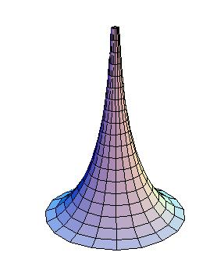
“Gabriel’s horn”

Slide 54
MYSTERY

Slide 55
The unreasonable effectiveness of applied mathematics

Slide 56
The unreasonable effectiveness of applied mathematics
Our universe ➔
our brains ➔
our math ➔
our universe

Slide 57
The unreasonable relevance of pure mathematics

Slide 58
The unreasonable relevance of pure mathematics
E.g.: Why should complex numbers (invented for no very compelling reason by Italian algebraists in the Renaissance) describe electromagnetism?

Slide 59
a quote from Gian-Carlo Rota
“Of all escapes from reality, mathematics is the most successful ever. It is a fantasy that becomes all the more addictive because it works back to improve the same reality we are trying to evade.”

Slide 60
The unreasonable tractability of mathematics

Slide 61
The unreasonable tractability of mathematics
“Who arranged those dominos?”
Or rather:
“Why are they so close together if nobody put them that way with our wishes in mind?”

Slide 62
The unreasonable interestingness of mathematics

Slide 63
The unreasonable interestingness of mathematics
How can we possibly be surprised by the consequences of rules that we ourselves have chosen?

Slide 64
from The Name of the Wind
“He also taught me a game called Seek the Stone. The point of the game was to have one part of your mind hide an imaginary stone in an imaginary room. Then you had another, separate part of your mind try to find it.”

Slide 65
Why should math be so generative of theorem after surprising theorem, when all we put into it is a handful of axioms and definitions?
Why should it appear to give us back more than we put into it?

Slide 66
Is this last mystery temporary?
Maybe human math is interesting to humans because our brains are broken.
Maybe as we as a species get better at math,
it'll become more boring.

Slide 67
But we're nowhere near that point yet.
For the past hundred years, mathematical history has been at the exact point
where C.S. Lewis took his leave of Narnia:

Slide 68
from The Last Battle
“All their life in this world and all their adventures in Narnia had only been the cover and the title page: now at last they were beginning Chapter One of the Great Story which no one on earth has read: which goes on forever: in which every chapter is better than the one before.”
And so…

Slide 69
“Further up and further in!”

Slide 70
I hope some of you will join the adventure.
Thank you for listening!

